Slide 1
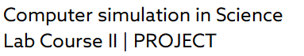
Three-body Problem By Runge-Kutta Solver Infrastructure (Earth, Sun and Jupiter) (Project 1)
8th February 2022
Aleksandar Mitic (2035177)
Dominik Wirsig (2020067)
Ravishankar Selvaraj (2036915)
2
Virtualization 2 | Project Phase

Slide 2
Three-body Problem By Runge-kutta Solver Infrastructure
Table of contents
Introduction
Backend
Frontend
Traefik
Docker-compose
Results and problems we faced
2
Virtualization 2 | Project Phase
A. Mitic, D. Wirsig, R. Selvaraj | Virtualization 2 1

Slide 3
Three-body Problem By Runge-kutta Solver Infrastructure
1. Introduction
In this project, we develop a simulation of Three Body problem which represents the movement of Earth, Sun and Jupiter. The solution is being done numerically via Runge-Kutta method.
Results are then represented graphically via Frontend website, which are given by plots and animation.
Project contains docker compose file, Dockerfile, traefik.yml file, HTML file and requirements text file.
TLS security is included but without real certificates. Containers are running on every machine. All of our work is spread and done in Backend and Frontend.
Our codes can be found on GitHub website.
2
Virtualization 2 | Project Phase
A. Mitic, D. Wirsig, R. Selvaraj | Virtualization 2 2

Slide 4
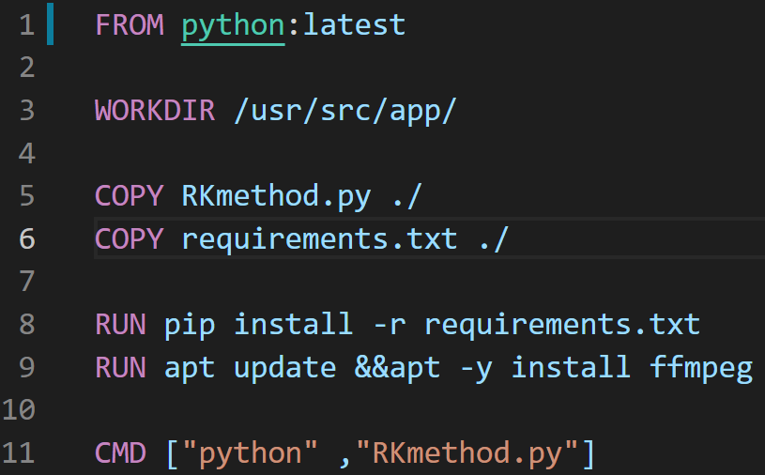
Three-body Problem By Runge-kutta Solver Infrastructure
2. Backend
2.1. Dockerfile
Docker can build images automatically by reading the instructions from a Dockerfile.
A Dockerfile is a text document that contains all the commands a user could call on the command line to assemble an image.
We are using 5 main commands in order to use the image, defining working directory, copying code, install libraries and run the script solver.
2
Virtualization 2 | Project Phase
A. Mitic, D. Wirsig, R. Selvaraj | Virtualization 2 3

Slide 5
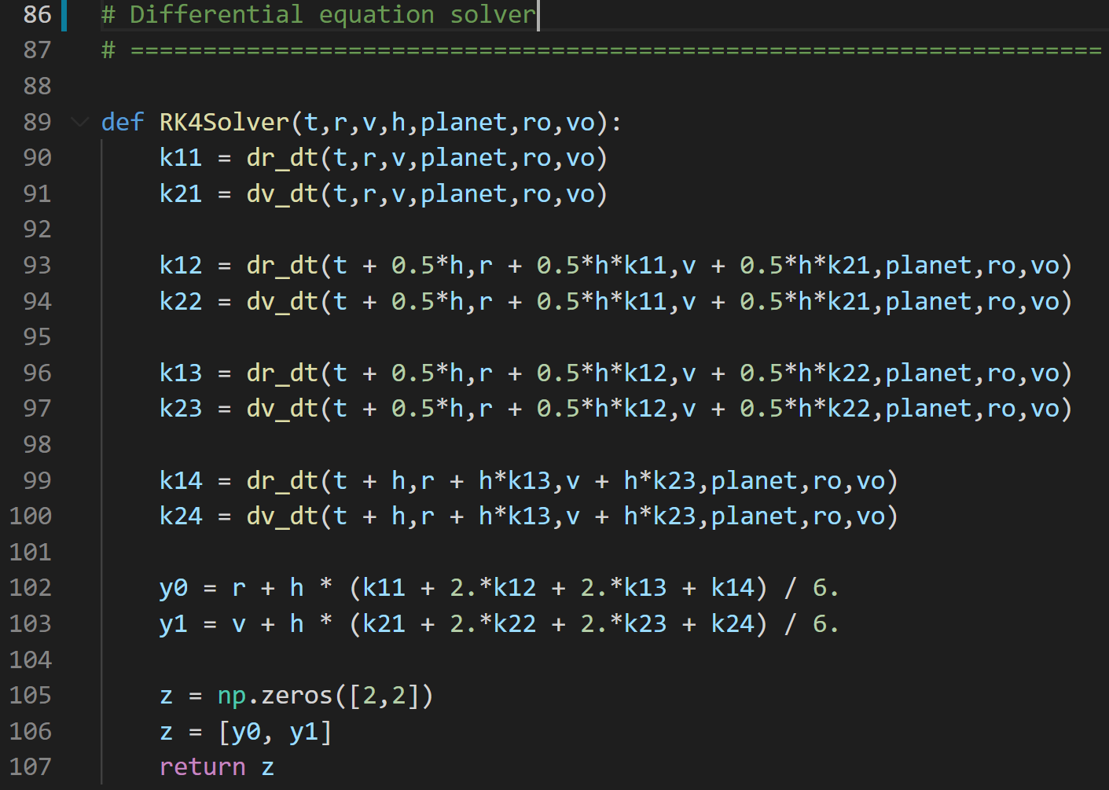
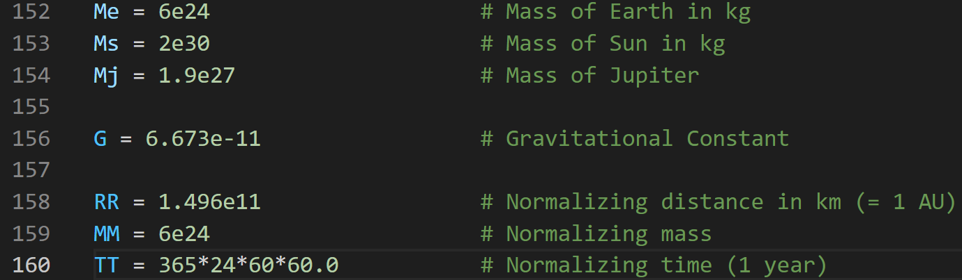
Three-body Problem By Runge-kutta Solver Infrastructure
2. Backend
2.2. Main script
Using Runge-Kutta method of 4th order, we are solving the 3-Body problem in order to simulate the movement of Sun, Earth and Jupiter.
All the inputs are preset, which are taken from the NASA website.
Outputs are plots and animation.
2
Virtualization 2 | Project Phase
A. Mitic, D. Wirsig, R. Selvaraj | Virtualization 2 4

Slide 6
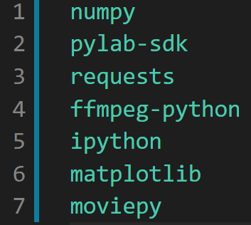
Three-body Problem By Runge-kutta Solver Infrastructure
2. Backend
2.3. Requirements
To keep the main Dockerfile simple, a separate file for the libraries is created (requirements.txt).
In order to be able to run our container in any environment, libraries are mentioned as a prerequisite.
If any problem occurs while running docker Container, first check on the libraries.
2
Virtualization 2 | Project Phase
A. Mitic, D. Wirsig, R. Selvaraj | Virtualization 2 5

Slide 7
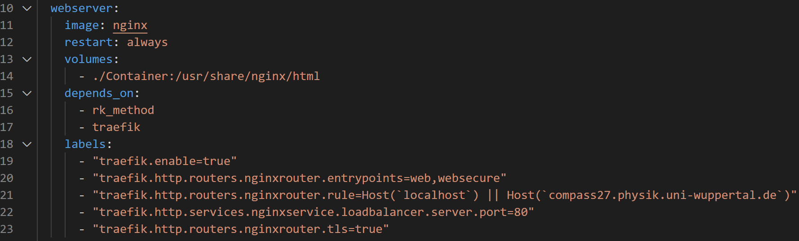
Three-body Problem By Runge-kutta Solver Infrastructure
3. Frontend
3.1 Web Server
Why we need a Web server? A web server is computer software and underlying hardware that accepts requests via HTTP or its secure variant HTTPS.
A user agent, commonly a web browser, initiates communication by making a request for a web page or other resource using HTTP, and the server responds with the content of that resource or an error message.
Web servers are used to present the results graphically on a website.
e.g. Apache and Nginx,etc.,
Why we are using nginx image as webserver?
Lightweight (low memory usage)
High performance
2
Virtualization 2 | Project Phase
A. Mitic, D. Wirsig, R. Selvaraj | Virtualization 2 6

Slide 8
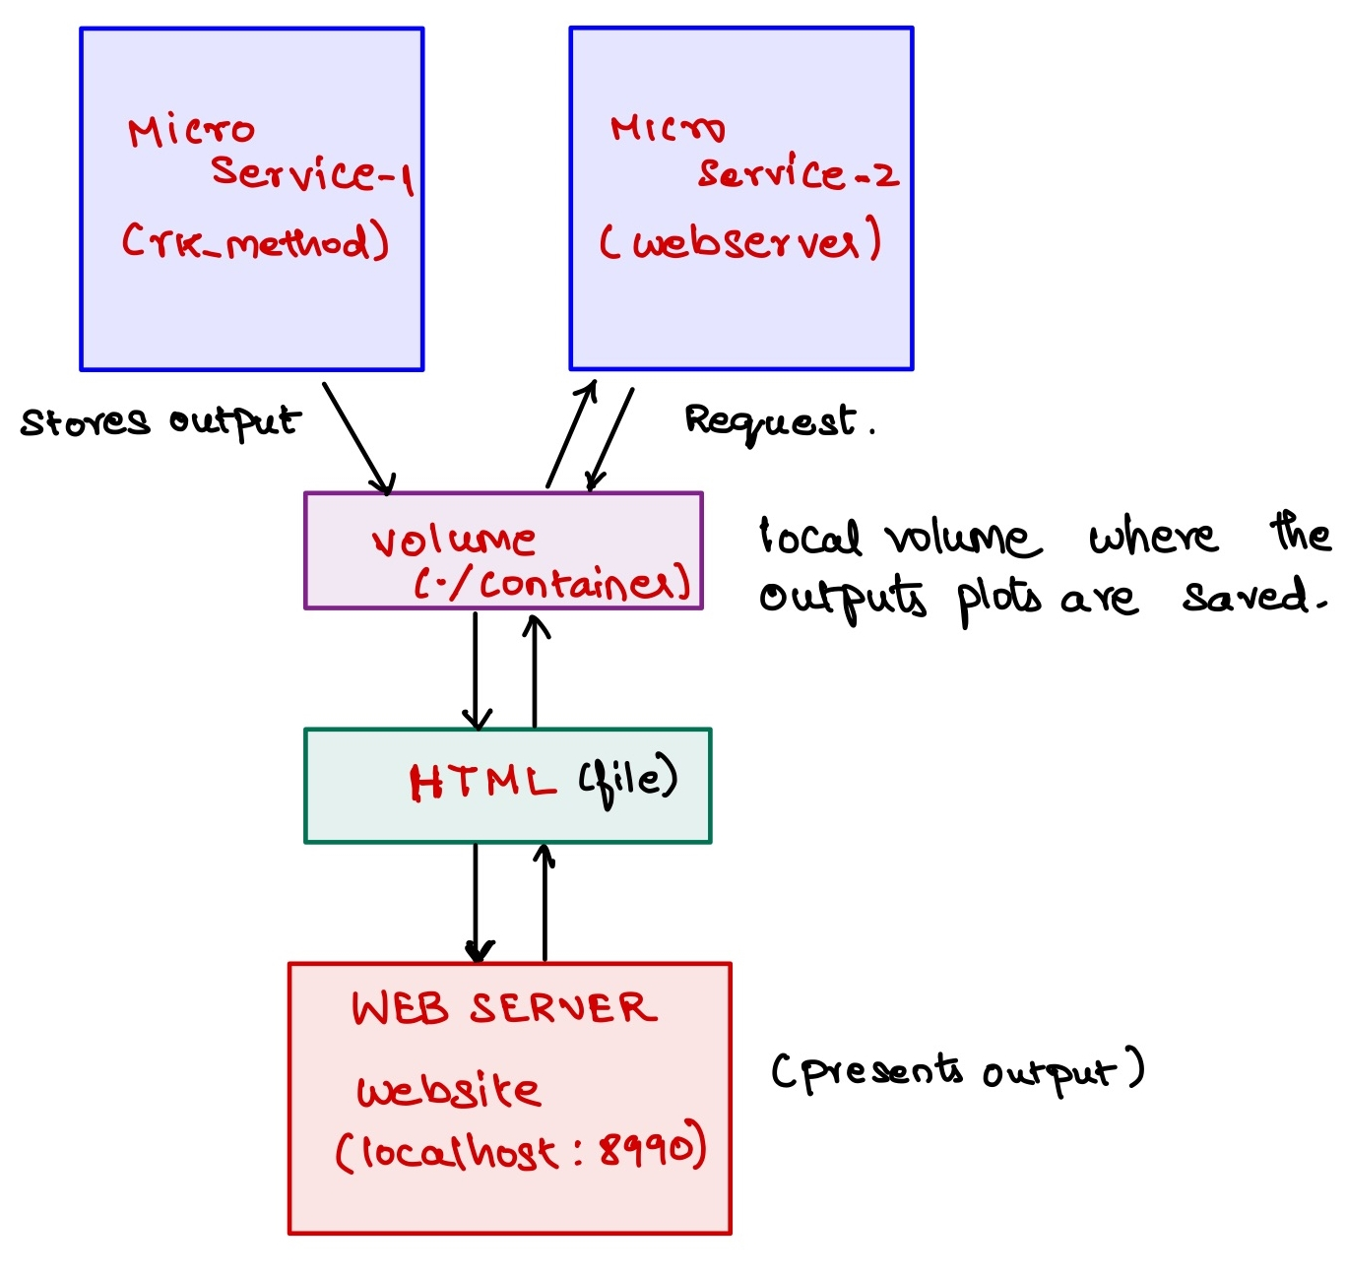
Three-body Problem By Runge-kutta Solver Infrastructure
3. Frontend
3.2 HTML
HTML (Hypertext Markup Language) is the code that is used to structure a web page and its content.
2
Virtualization 2 | Project Phase
A. Mitic, D. Wirsig, R. Selvaraj | Virtualization 2 7

Slide 9
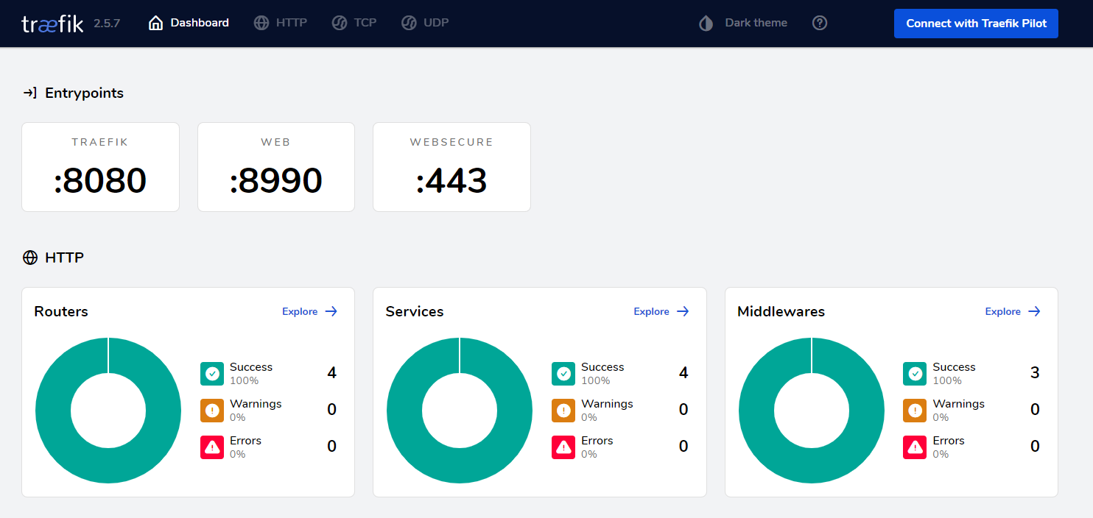
Three-body Problem By Runge-kutta Solver Infrastructure
4. Traefik
What traefik is used for?
Traefik is used for:
Routing
Load Balancing
and Reverse proxy, etc.
2
Virtualization 2 | Project Phase
A. Mitic, D. Wirsig, R. Selvaraj | Virtualization 2 8

Slide 10
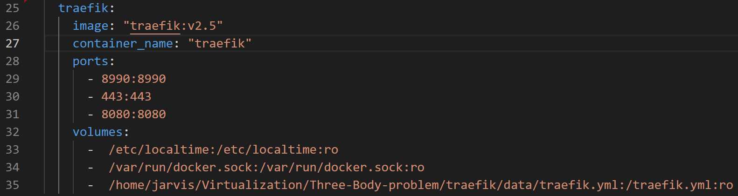
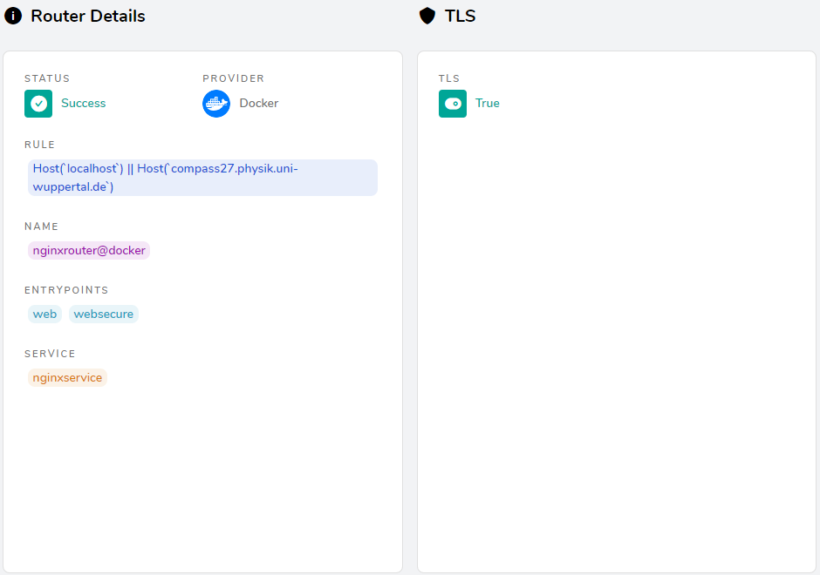
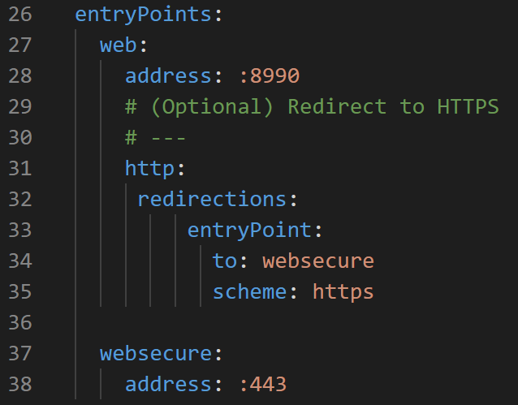
Three-body Problem By Runge-kutta Solver Infrastructure
4. Traefik
4.1 Entrypoints
We used Entrypoint 443 for
websecure
Entrypoint 8080 for dashboard
Entrypoint 8990 (http) for Frontend webserver, which will redirect to secured website (https-Entrypoint:443)
2
Virtualization 2 | Project Phase
A. Mitic, D. Wirsig, R. Selvaraj | Virtualization 2 9

Slide 11
Three-body Problem By Runge-kutta Solver Infrastructure
5. Docker-Compose
5.1 Docker-compose
Docker-Compose is a tool that was developed to help define and share multi-container applications. With Compose, we can create a YAML file to define the services and with a single command, can spin everything up or tear it all down.
Command: docker-compose up –d
docker-compose down
For traefik: docker logs traefik
We have 3 microservices running inside docker-compose
rk_method
webserver (which connects to frontend website)
traefik (which used for routing)
2
Virtualization 2 | Project Phase
A. Mitic, D. Wirsig, R. Selvaraj | Virtualization 2 10

Slide 12
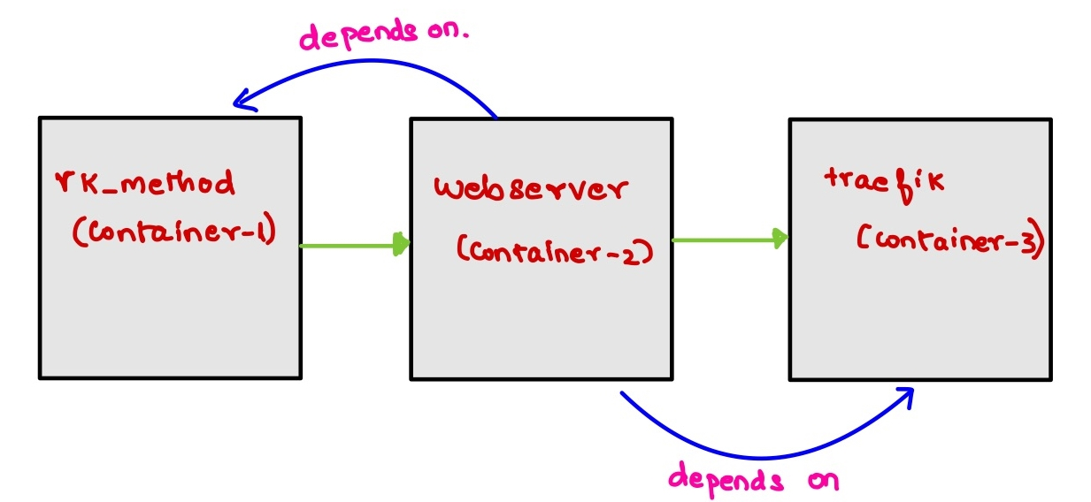
Three-body Problem By Runge-kutta Solver Infrastructure
5. Docker-Compose
What happens when you run our docker-compose?
Initially, the first container (rk_method) is executed, which contains a Docker file and a solver. And it stores the outputs in a local volume
Then the second container (web server) is started, which requests the output to the first container and projects the results to the website via Traefik routing
Finally, it runs the Third container (traefik) on which webserver (container -2 ) depends.
2
Virtualization 2 | Project Phase
A. Mitic, D. Wirsig, R. Selvaraj | Virtualization 2 11

Slide 13
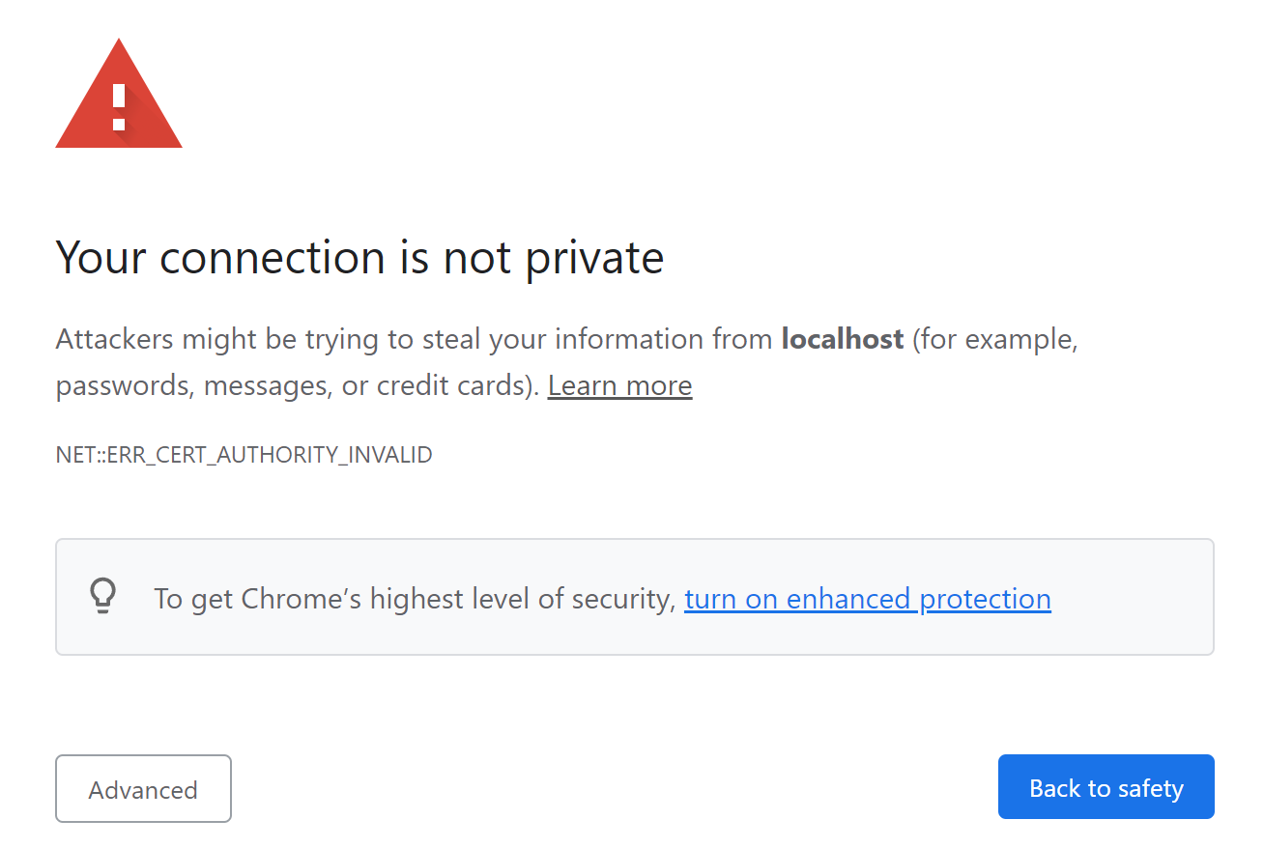
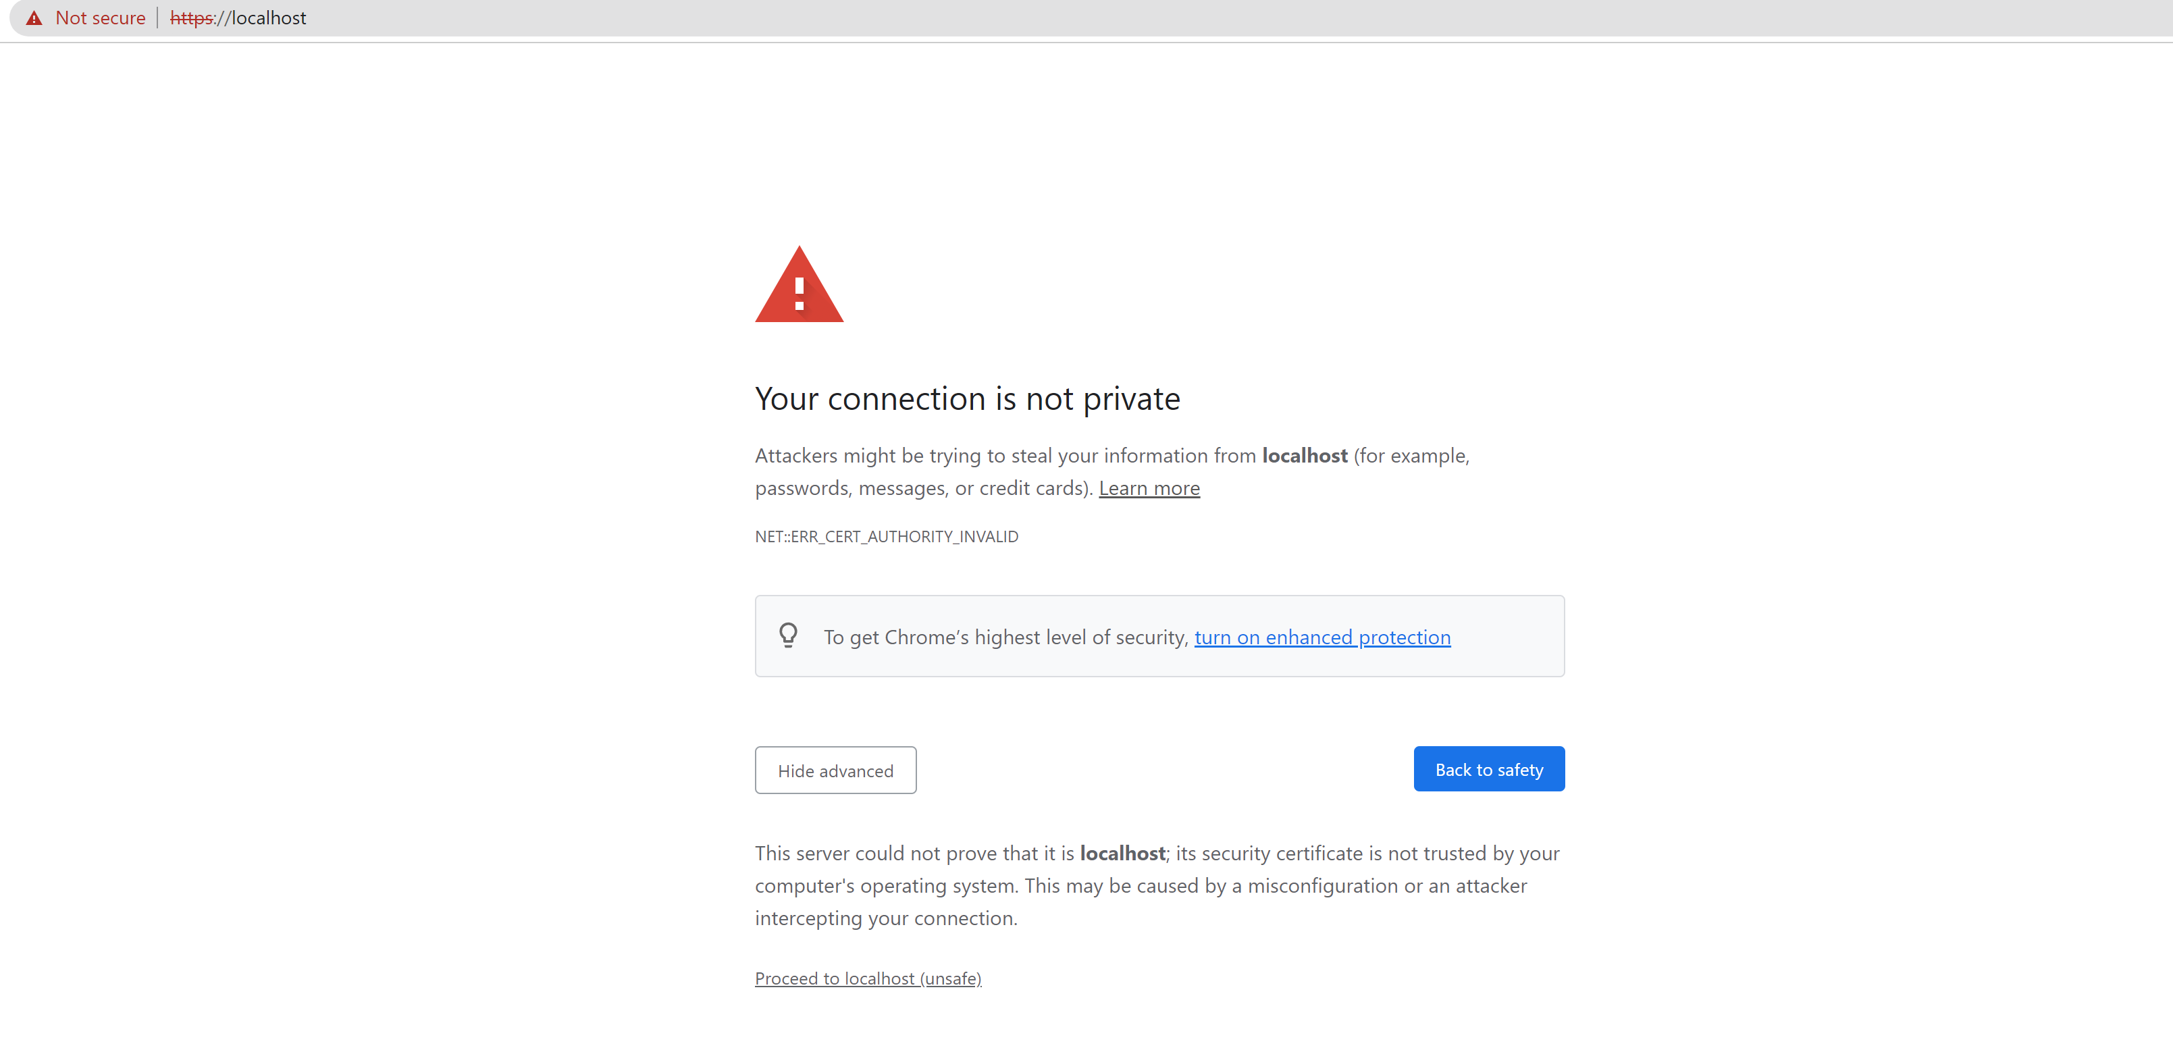
Three-body Problem By Runge-kutta Solver Infrastructure
6. Results
Entering localhost:8990 in browser it redirects to secured frontend website with Entrypoint localhost:443
Proceed to localhost(unsafe)
2
Virtualization 2 | Project Phase
A. Mitic, D. Wirsig, R. Selvaraj | Virtualization 2 12

Slide 14
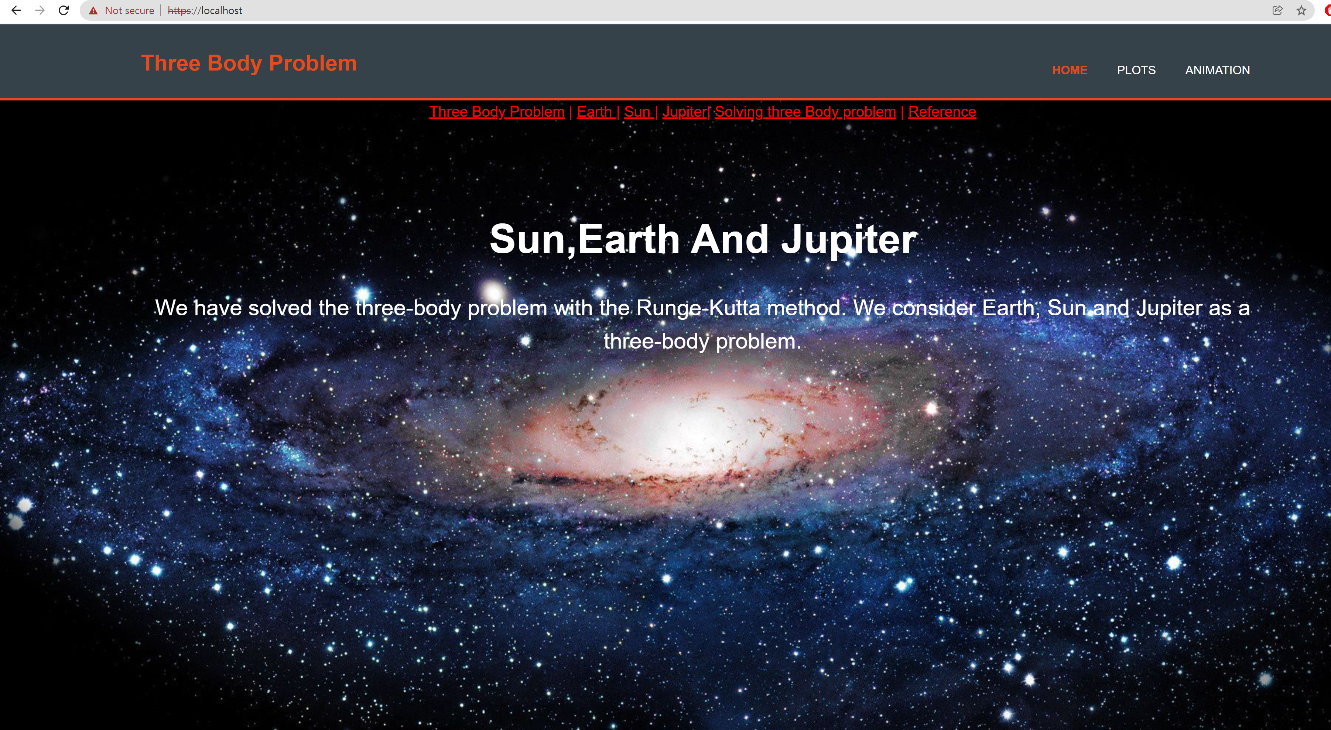
Three-body Problem By Runge-kutta Solver Infrastructure
6. Results
2
Virtualization 2 | Project Phase
A. Mitic, D. Wirsig, R. Selvaraj | Virtualization 2 13

Slide 15
Three-body Problem By Runge-kutta Solver Infrastructure
Problems we face during project
Saving animation - Library that allows us to save the animation in local volume
Allocating Volume - Same volume for two Containers (to address the graphical results)
HTML - User interface, workflow and design
Web server image - nginx
Database - storing the results
Traefik routing - Entrypoints
Labels - rule=host
2
Virtualization 2 | Project Phase
A. Mitic, D. Wirsig, R. Selvaraj | Virtualization 2 14

Slide 16
Three-body Problem By Runge-kutta Solver Infrastructure
References
Three-body-problem by Runge-kutta method https://www.phas.ubc.ca/~berciu/TEACHING/PHYS349/karla.pdf
Earth fact sheet: https://nssdc.gsfc.nasa.gov/planetary/factsheet/earthfact.html
Jupiter fact sheet: https://nssdc.gsfc.nasa.gov/planetary/factsheet/jupiterfact.html
Sun fact sheet: https://nssdc.gsfc.nasa.gov/planetary/factsheet/sunfact.html
RK method: https://github.com/zaman13/Three-Body-Problem-Gravitational-System/tree/master/Python%20script
2
Virtualization 2 | Project Phase
A. Mitic, D. Wirsig, R. Selvaraj | Virtualization 2 15

Slide 17
Three-body Problem By Runge-kutta Solver Infrastructure
THANK YOU
2
Virtualization 2 | Project Phase
A. Mitic, D. Wirsig, R. Selvaraj | Virtualization 2

